Slide 1
MEDICINAL PLANT IDENTIFICATION USING MACHINE LEARNING
GUIDED BY :
Dr.A.Bhavani Sankar
B.E., M.E., Ph.D
Professor and Head,
Department of Electronics and Communication Engineering.
BATCH MEMBERS :
M.Mugesh - 820420106032
K.Mamannan - 820420106025
S.G.Mohan - 820420106031
D.Dhasarathan - 820420106013

Slide 2
PROJECT OBJECTIVE
The objective of a medicinal plant identification project is to develop a system that can accurately identify various species of medicinal plants from images.
It proposes a deep learning-based approach that uses a convolutional neural network (CNN). the CNN is capable of learning and representing complex features in images, enabling it to recognize and classify medicinal plants with high accuracy

Slide 3
LITERATURE REVIEW
S.no | Title of the Paper | Author | Journal Name | Year of Published | Description
1 | Automated Real-Time Identification of Medicinal Plants Species in Natural Environment Using Deep Learning Models | Owais A. Malik, Nazrul Ismail,Burhan R. Hussein and Umar Yahya | National Library of Medicine National Center For Biotechnology Information | 2022 | It was achieved 87% and 84% Top-1 accuracies on a test set for the private and public datasets, respectively, which is more than a 10% accuracy improvement compared to the baseline model.

Slide 4
S.no | Title of the Paper | Author | Journal Name | Year of Published | Description
2 | Medicinal Plant identification in the wild by using CNN | Trung Nguyen Quoc, Vinh Truong Hoang | IEEE | 2020 | Used Convolutional Neural Network (CNN) to recognize Vietnamese medicinal plant images in this paper.he highest accuracy reached by Xception with 88.26%.

Slide 5
S.no | Title of the Paper | Author | Journal Name | Year of Published | Description
3 | Medicinal Plant Recognition based on CNN and Machine Learning | Bhanuprakash Dudi, Dr.V.Rajesh | International Journal of Advanced Trends in Computer Science and Engineering | 2019 | This data is fed as the training dataset for the CNN and machine learning based proposed system. An accuracy has been achieved in the recognition of the medicinal plant species.

Slide 6
Modules
Module 1 : Gather diverse images of medicinal plants, ensuring comprehensive coverage of species. Annotate the dataset with plant species labels for supervised learning.
Module 2 : Divide the dataset into training, validation, and testing sets for model training and evaluation. Choose a pre-trained CNN for feature extraction, considering its effectiveness in image recognition.
Module 3 : Optimize model parameters for enhanced performance. Evaluate the model using the Training set to ensure accurate identification. Create a user-friendly interface for seamless plant image upload and identification

Slide 7
PROS
Accurate identification ensures the proper utilization of plant resources for medicinal purposes, potentially leading to breakthroughs in healthcare.
Many medicinal plants are endangered due to overharvesting and habitat destruction
CONS
Identifying medicinal plants can be challenging due to the vast diversity of plant species
Building a comprehensive dataset of medicinal plant images for training machine learning models can be difficult due to limited access to plant specimens, particularly for rare or endangered species.

Slide 8
EXISTING METHOD
Ensemble Deep Learning – Automated Medicinal Leaf Identification (EDL –AMLI) that averaged the results from several different models.
Not More Accurate Results were achieved when using more data to train

Slide 9
Application
Healthcare and Medicine : Accurate Identification of Medicinal plants is crucial for ensuring the safe and effective use of traditional herbal remedies
Traditional Knowledge Preservation : Indigenous communities often have valuable knowledge about the uses and the properties of medicinal plants
Education and Awareness : A medicinal plant identification system can be used as an educational tool to raise awareness about the important of traditional medicine

Slide 10
PROPOSED METHOD
Deep Learning:
Deep Learning is a subset of machine learning that focuses on neural networks with multiple layer. Deep learning models automatically learn hierarchical representations of features from raw data.
Convolutional Neural Networks(CNN):
Convolutional Neural Networks (CNNs) are a type of deep learning model primarily used for processing and analyzing visual data.
Image identification tasks, leading to superior accuracy compared to traditional machine learning algorithms.

Slide 11
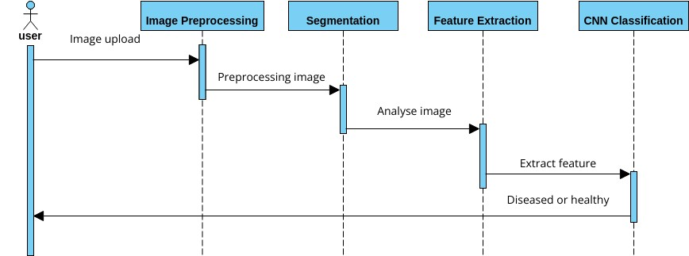
SEQUENCE DIAGRAM

Slide 12
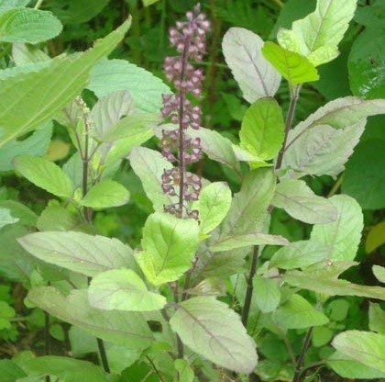
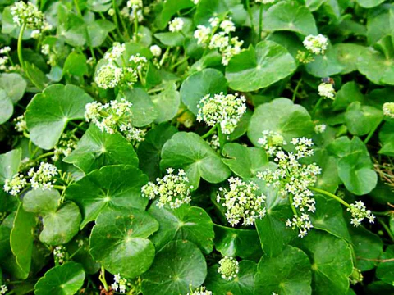
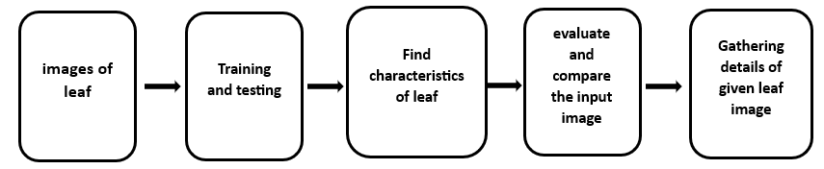
FLOWCHART
Tulsi
Gotukola

Slide 13
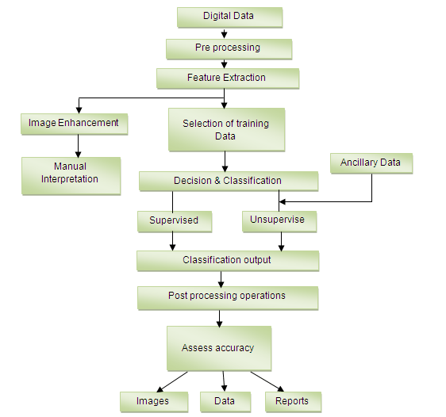
BLOCK DIAGRAM

Slide 14
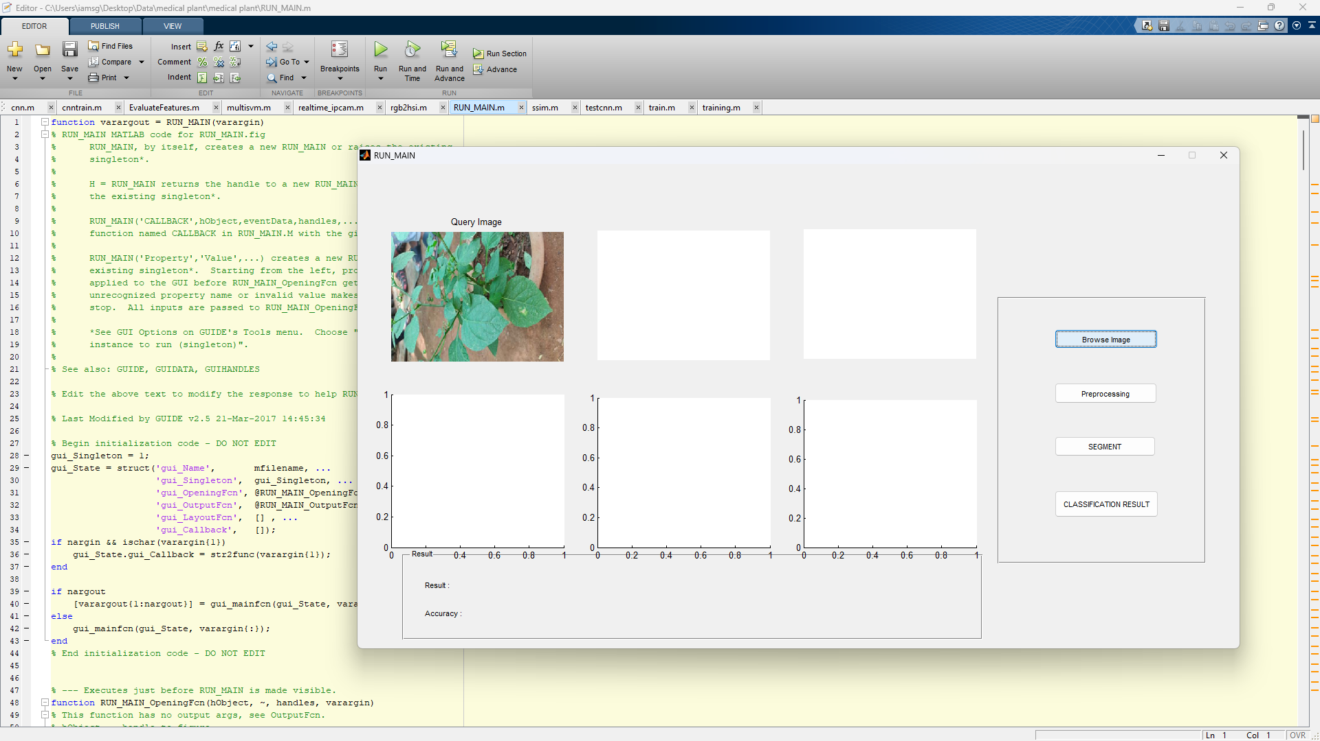
INPUT IMAGE:

Slide 15
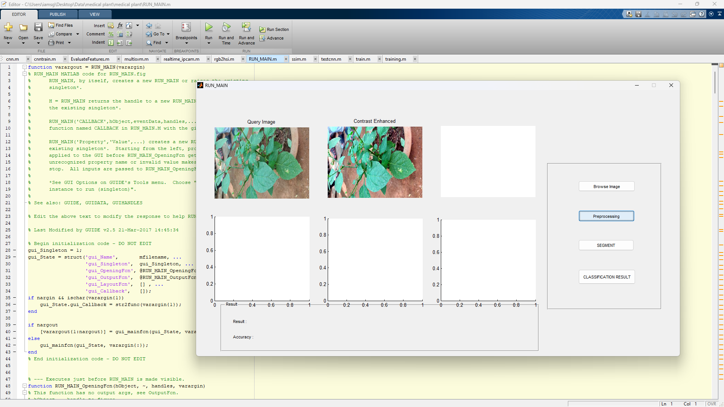
PREPROCESSING :

Slide 16
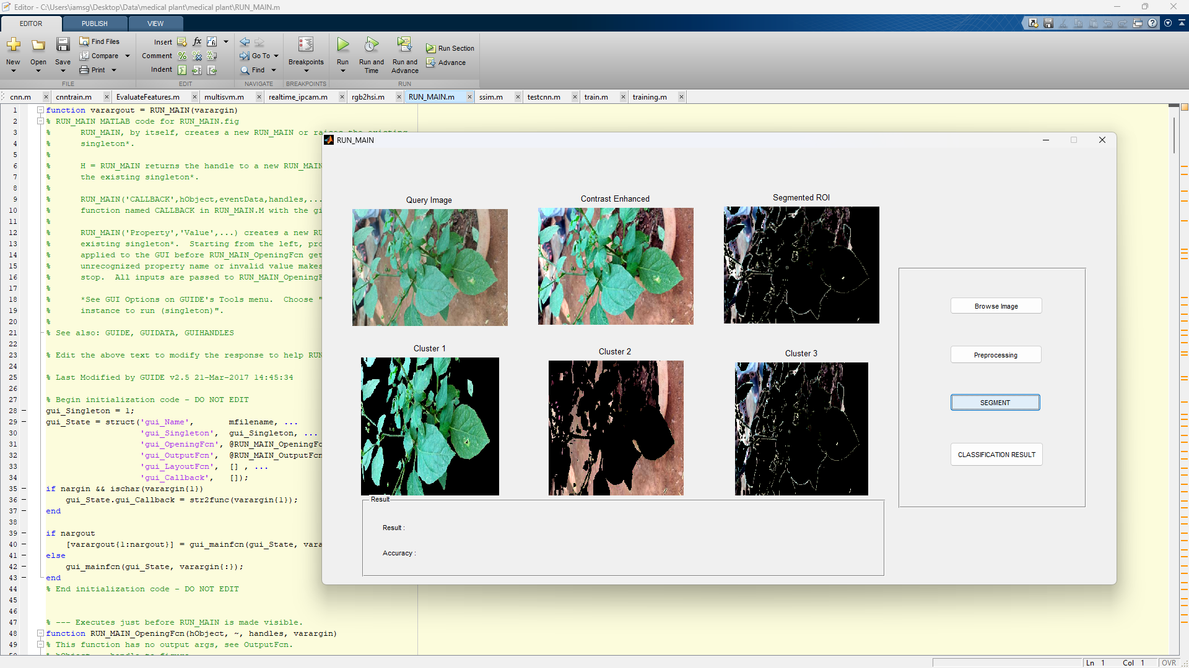
SEGMENTATION :

Slide 17
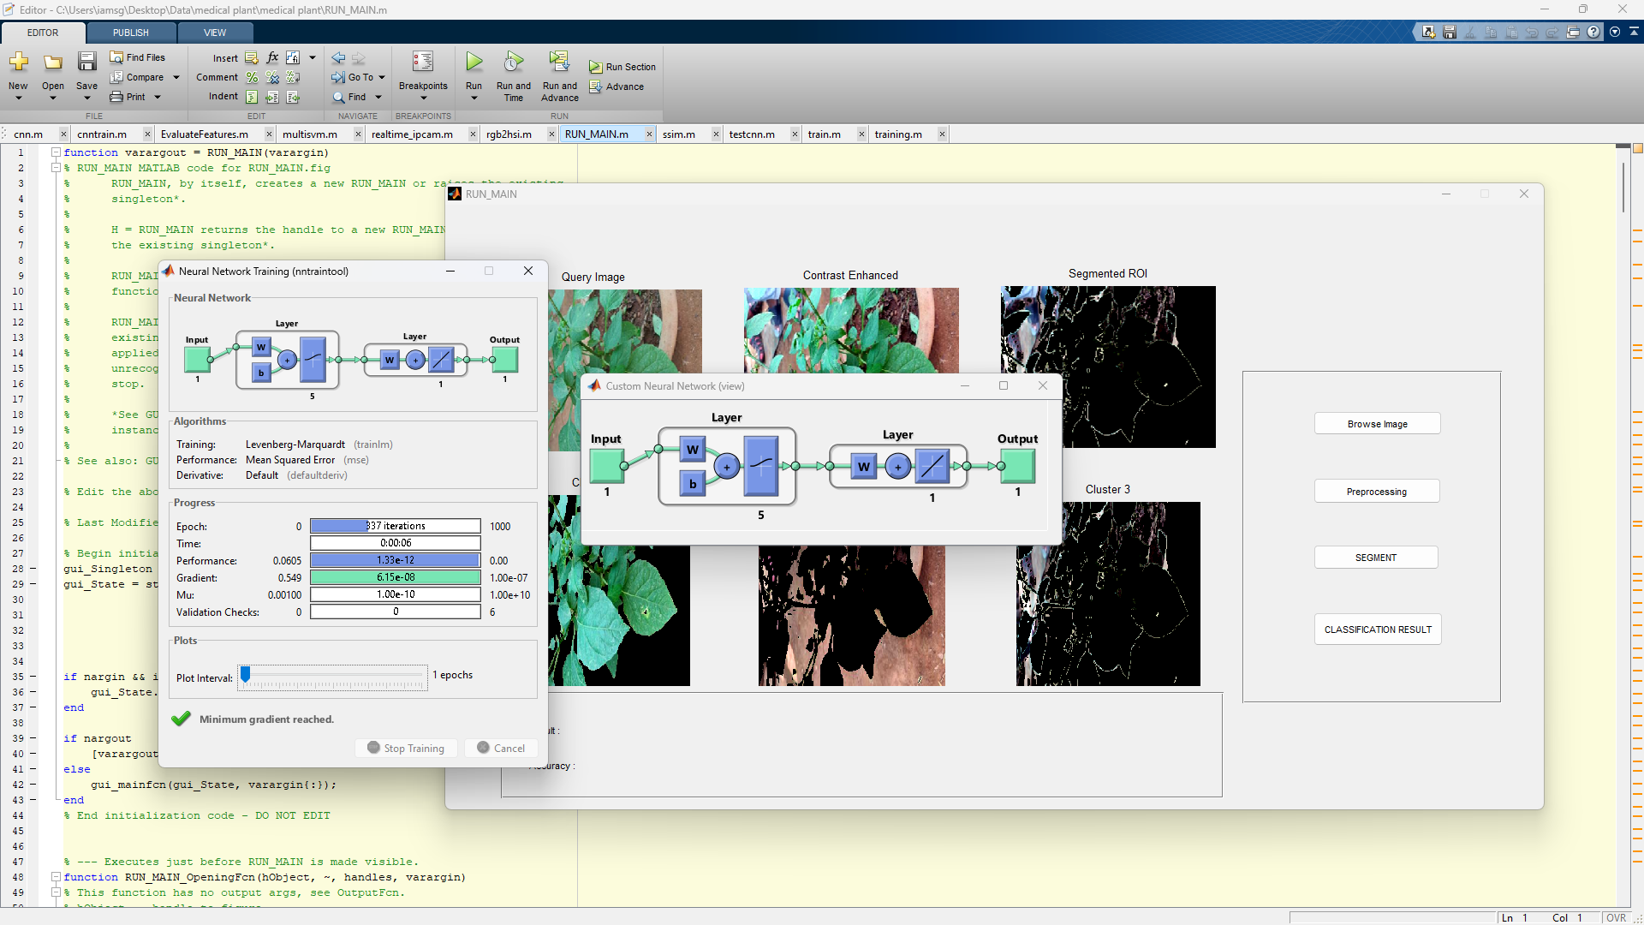
PROCESSING :

Slide 18
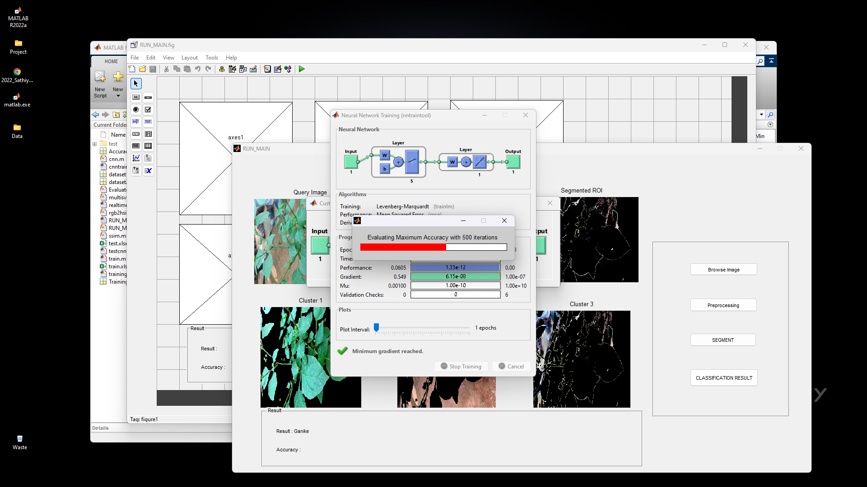
EVALUATING :

Slide 19
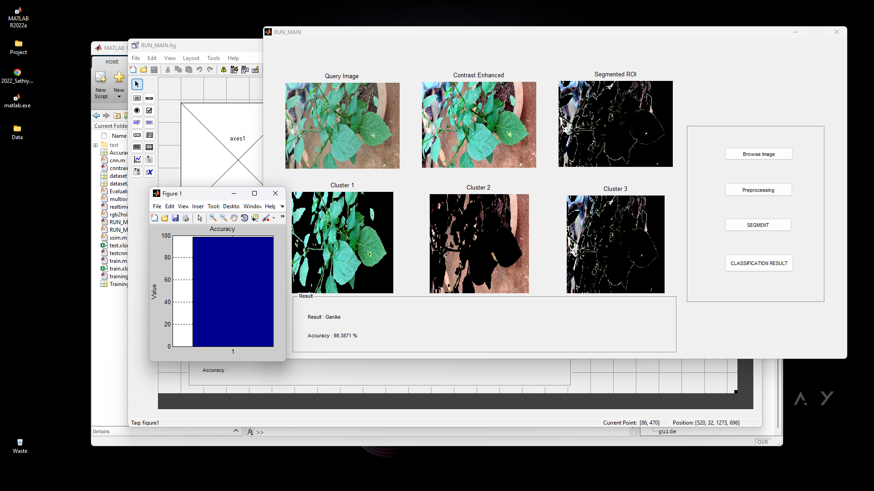
RESULT :

Slide 20
FUTURE ENHANCEMENTS :
Use More Advanced AI - based Classifier To Improve Function
Train More Types of plants to improve accuracy of Identify plants

Slide 21
REQUIREMENTS
Hardware
Software
Processor (CPU)
Graphics Processing Unit (GPU)
Network Connectivity
Data Backup
Functional Requirements:
Image Input
Identification Algorithm
Real-time Processing
Database Integration
Non-Functional Requirements:
Performance
Reliability
Compatibility
Maintainability
Usability

Slide 22
THANK YOU

